Slide 1
VISIBLE
LILIGHT

Slide 2
VISIBLE
LIGHT

Slide 3
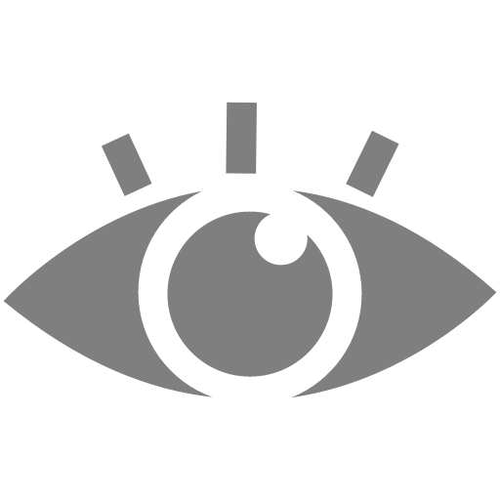

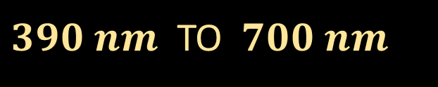

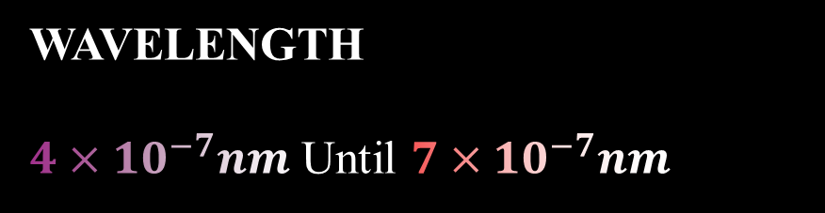
Electromagnetics waves
DEFINITION
&
THE SPECTRUME OF VISIBLE LIGHT
WAVELENGTH
$4×{10}^{−7}nm$ Until $7×{10}^{−7}nm$
FREQUENCY
$460 THz$ Until $780$THz
VISIBLE
LIGHT
Will response to
wavelength
$390 nm$ TO $700 nm$
It Has Frequencies about
430 THz until 770 THz
The visible wavelength allow us to see

Slide 4
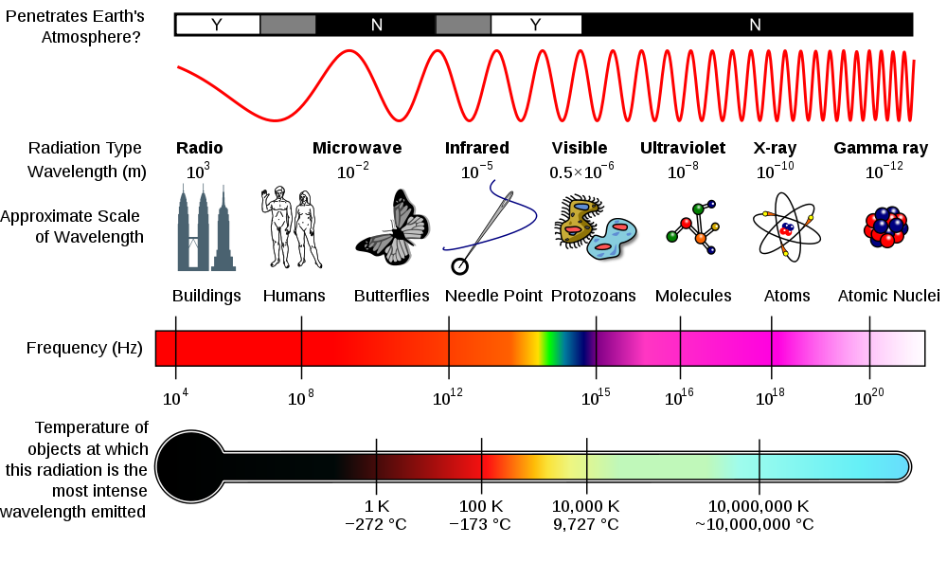

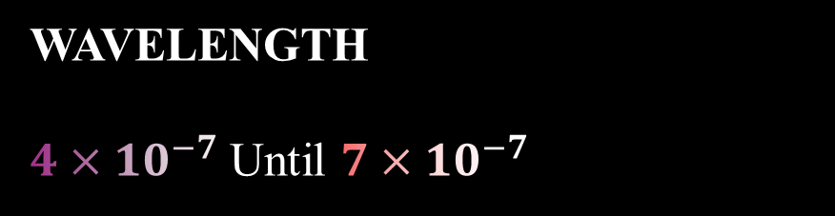

Electromagnetics waves
WAVELENGTH
$4×{10}^{−7}$ Until $7×{10}^{−7}$
FREQUENCY
$4,6×{10}^{14} Hz$ Until $7,8×{10}^{14}$Hz
Will response to
wavelength
$390 nm$ TO $700 nm$
DEFINITION
&
THE SPECTRUME OF VISIBLE LIGHT
It Has Frequencies about
430 THz until 770 THz
The visible wavelength allow us to see
VISIBLE
LIGHT

Slide 5
Each color in this visual range has a different wavelength. Red has the longest wavelength
(700 nm) and violet has the shortest wavelength (400 nm)
COLOR | WAVELENGTH (nm) | Frequencies (THz)
RED | 620-780 | 460-482
ORANGE | 590-620 | 482-503
YELLOW | 570-590 | 503-520
GREEN | 490-570 | 520-610
BLUE | 440-490 | 610-659
INDIGO | 420-440 | 659-769
VIOLET | 390-420 | 688-789
DEFINITION
&
THE SPECTRUME OF VISIBLE LIGHT
VISIBLE
LIGHT

Slide 6
Each color in this visual range has a different wavelength. Red has the longest wavelength
(700 nm) and violet has the shortest wavelength (400 nm)
COLOR | WAVELENGTH (nm) | Frequencies (THz)
RED | 620-780 | 460-482
ORANGE | 590-620 | 482-503
YELLOW | 570-590 | 503-520
GREEN | 490-570 | 520-610
BLUE | 440-490 | 610-659
INDIGO | 420-440 | 659-769
VIOLET | 390-420 | 688-789
DEFINITION
&
THE SPECTRUME OF VISIBLE LIGHT
VISIBLE
LIGHT

Slide 7
Each color in this visual range has a different wavelength. Red has the longest wavelength
(700 nm) and violet has the shortest wavelength (400 nm)
FOUNDER
VISIBLE
LIGHT
DEFINITION
&
THE SPECTRUME OF VISIBLE LIGHT
COLOR | WAVELENGTH (nm) | Frequencies (THz)
RED | 620-780 | 460-482
ORANGE | 590-620 | 482-503
YELLOW | 570-590 | 503-520
GREEN | 490-570 | 520-610
BLUE | 440-490 | 610-659
INDIGO | 420-440 | 659-769
VIOLET | 390-420 | 688-789

Slide 8
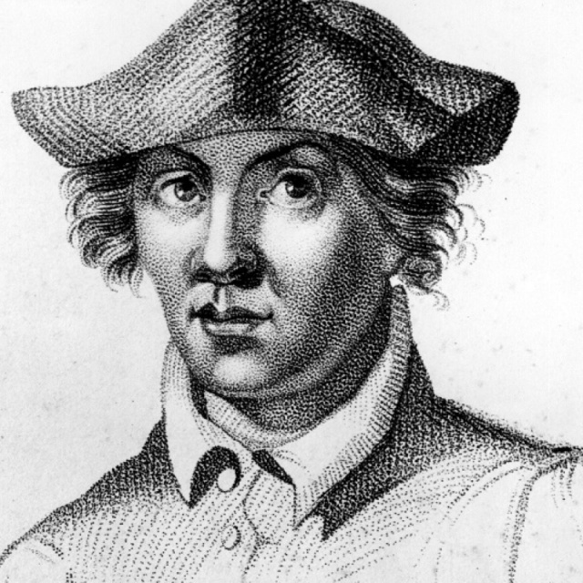




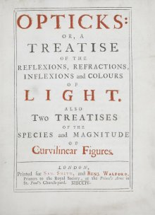
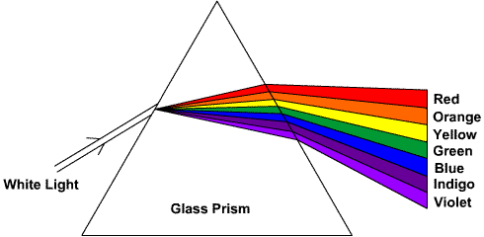
ROGER
BACON
(1214 – 1292)
English Philosopher
Franciscan Friar
who placed considerable emphasis on the study of nature through empiricism.
FOUNDER
In the 13th century, Roger Bacon theorized that
VISIBLE
LIGHT
DEFINITION
&
THE SPECTRUME OF VISIBLE LIGHT
SIR ISSAC
NEWTON
(4 January 1643-4 January 1643)
In the 17th century, Isaac Newton discovered that

Slide 9
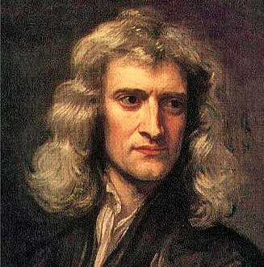
ROGER
BACON
(1214 – 1292)
English Philosopher
Franciscan Friar
who placed considerable emphasis on the study of nature through empiricism.
In the 13th century, Roger Bacon theorized that
SIR ISSAC
NEWTON
(4 January 1643-4 January 1643)
FOUNDER
In the 17th century, Isaac Newton discovered that
VISIBLE
LIGHT
DEFINITION
&
THE SPECTRUME OF VISIBLE LIGHT

Slide 10
SIR ISSAC
NEWTON
(4 January 1643-4 January 1643)
THE MECHANISM
In the 17th century, Isaac Newton discovered that
VISIBLE
LIGHT
DEFINITION
&
THE SPECTRUME OF VISIBLE LIGHT
FOUNDER

Slide 11
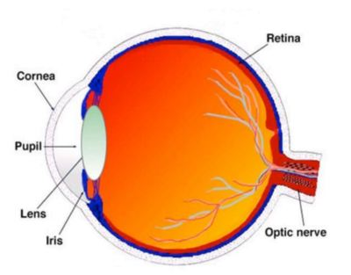
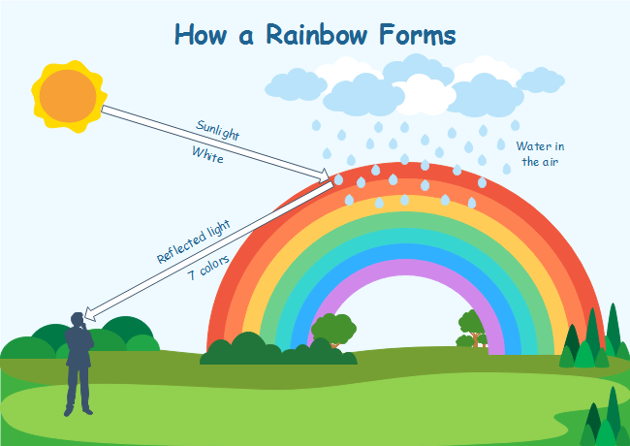
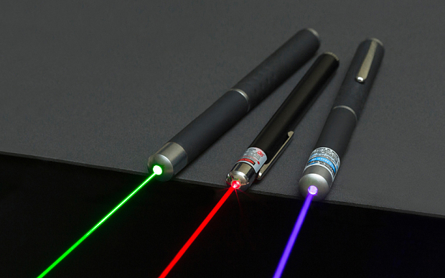
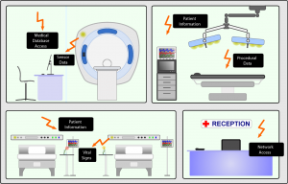
THE
MECHANISM
Visible light consisting of seven colors when combined will become white light
Light that enters the eye through the pupil ultimately strikes the inside surface of the eye known as the retina.
VISIBLE
LIGHT
DEFINITION
&
THE SPECTRUME OF VISIBLE LIGHT
FOUNDER
Rainbow
When entering the glass prism the light will be turned, as well as the light coming out of the glass prism. Prism also separates white light into its color component. The raindrop function like prisms.
2. Laser
laser is a device that emits light through a process of optical amplification based on the stimulated emission of electromagnetic radiation.
3. Visible Light Communication ( Hospital & Health care ):
There are advantages for using VLC in hospitals and in healthcare. Mobile phones and Wifi’s are undesirable in certain parts of hospitals, especially around MRI scanners and in operating theatres.

Slide 12
Visible light consisting of seven colors when combined will become white light
Light that enters the eye through the pupil ultimately strikes the inside surface of the eye known as the retina.
Rainbow
When entering the glass prism the light will be turned, as well as the light coming out of the glass prism. Prism also separates white light into its color component. The raindrop function like prisms.
THE
APPLICATION
2. Laser
laser is a device that emits light through a process of optical amplification based on the stimulated emission of electromagnetic radiation.
3. Visible Light Communication ( Hospital & Health care ):
There are advantages for using VLC in hospitals and in healthcare. Mobile phones and Wifi’s are undesirable in certain parts of hospitals, especially around MRI scanners and in operating theatres.
VISIBLE
LIGHT
DEFINITION
&
THE SPECTRUME OF VISIBLE LIGHT
FOUNDER
2. Spectrophotometry VIS

Slide 13
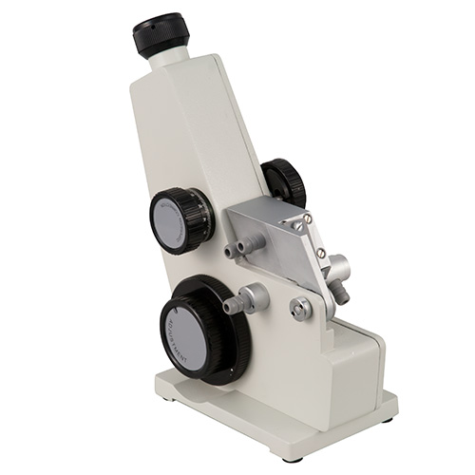
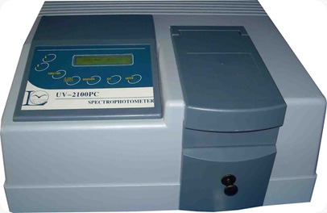
Rainbow
When entering the glass prism the light will be turned, as well as the light coming out of the glass prism. Prism also separates white light into its color component. The raindrop function like prisms.
2. Laser
laser is a device that emits light through a process of optical amplification based on the stimulated emission of electromagnetic radiation.
3. Visible Light Communication ( Hospital & Health care ):
There are advantages for using VLC in hospitals and in healthcare. Mobile phones and Wifi’s are undesirable in certain parts of hospitals, especially around MRI scanners and in operating theatres.
4.Refractometer
Refractometers are mostly used to determine the index of refraction of liquid samples, and to measure fluid concentrations, such as blood proteinconcentration, sugar content, and salinity.
THE
APPLICATION
5. Spectrophotometry VIS
Spectrophotometry is one method in chemical analysis that is used to determine the composition of a sample both quantitatively and qualitatively based on the interaction between matter and light
VISIBLE
LIGHT
DEFINITION
&
THE SPECTRUME OF VISIBLE LIGHT
FOUNDER

Slide 14
Spectrophotometry VIS
THE
APPLICATION
VISIBLE
LIGHT
DEFINITION
&
THE SPECTRUME OF VISIBLE LIGHT
FOUNDER

Slide 15
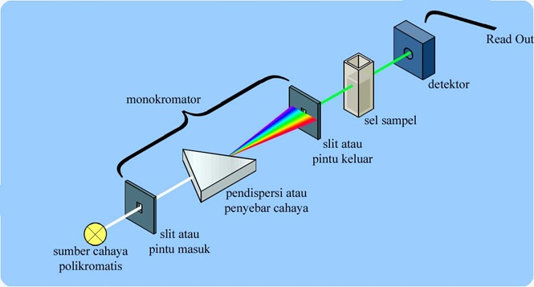
Visible Light is part of the electromagnetic wave radiation that can be detected (recognized) by the human eye.
Inventor of the Light Wave Looks Roger Bacon, the first time the spectrum is seen in a glass of air. Four centuries later, Isaac Newton discovered that prisms can disassemble and reinstall white light.
Spectrophotometry VIS
THE
APPLICATION
Polycromatic light sources function as polycromatic light sources with various wavelength ranges. For spectrophotometers VIS uses tungsten lamps which are often called tungsten lamps.
Monochromators function as selectors of wavelengths that convert light from polycromatic light sources to light monochromatic
The sample cell serves as a place to place the sample. visible light uses cuvettes as sample sites
The detector functions to capture the light transmitted from the sample and turn it into an electric current
Read out is a reading system that captures the magnitude of electrical signals coming from the detector.
VISIBLE
LIGHT
DEFINITION
&
THE SPECTRUME OF VISIBLE LIGHT
FOUNDER

Slide 16
Visible Light is part of the electromagnetic wave radiation that can be detected (recognized) by the human eye.
Inventor of the Light Wave Looks Roger Bacon, the first time the spectrum is seen in a glass of air. Four centuries later, Isaac Newton discovered that prisms can disassemble and reinstall white light.
THE CONCLUSION
VISIBLE
LIGHT
DEFINITION
&
THE SPECTRUME OF VISIBLE LIGHT
FOUNDER
Spectrophotometry VIS
Polycromatic light sources function as polycromatic light sources with various wavelength ranges. For spectrophotometers VIS uses tungsten lamps which are often called tungsten lamps.
Monochromators function as selectors of wavelengths that convert light from polycromatic light sources to light monochromatic
The sample cell serves as a place to place the sample. visible light uses cuvettes as sample sites
The detector functions to capture the light transmitted from the sample and turn it into an electric current
Read out is a reading system that captures the magnitude of electrical signals coming from the detector.

Slide 17
Visible Light is part of the electromagnetic wave radiation that can be detected (recognized) by the human eye.
Inventor of the Light Wave Looks Roger Bacon, the first time the spectrum is seen in a glass of air. Four centuries later, Isaac Newton discovered that prisms can disassemble and reinstall white light.
DO YOU HAVE ANY QUESTIONS?
FOUNDER
VISIBLE
LIGHT
DEFINITION
&
THE SPECTRUME OF VISIBLE LIGHT

Slide 18
Visible Light is part of the electromagnetic wave radiation that can be detected (recognized) by the human eye.
Inventor of the Light Wave Looks Roger Bacon, the first time the spectrum is seen in a glass of air. Four centuries later, Isaac Newton discovered that prisms can disassemble and reinstall white light.
THANKYOU
FOUNDER
VISIBLE
LIGHT
DEFINITION
&
THE SPECTRUME OF VISIBLE LIGHT

